Slide 1
GWU Data Project 2 ARG team
By Pius Odhiambo

Slide 2
Project Summary
This project is about tracking down the disbursement of SBA loans from 2012 – 2020 within the United States of America.
I am using same data source as team J2P2 but Gemini Removed P = J2P

Slide 3
Presentation – 20 minutes
Power Point Slides – 4 minutes
Data Story – 7 minutes
Tools - 4 ( Power BI / Tableau ) minutes
Q & A – 4 minutes

Slide 4
4 Facts about Mr. Pius 2 True Facts / 2 False
A good team player -True
Spoke English for the first time when he relocated to the United States -False
A victim of COVID-19 pandemic –Indirectly True (False)
Got a 6 figure job courtesy of GWU DataViz BootCamp -True
Prize – “The Magic Box”

Slide 5
Front End Technologies
Power BI Desktop | Services
HTML 5
CSS

Slide 6
Back End Technologies
SQL Server
Python (Pandas Library, Shutil Library, OS Library)
SQL Server Integration Services
SQL Server Management Studio
Google Cloud SQL Instance
Github
Shutil is an ETL library in Python

Slide 7
Process
Create a google account
Provision Cloud SQL Instance
Create Database
Create Connection btw the Database and SSMS
Load Data into the Database using SISS
Connect your Data to Power BI

Slide 8
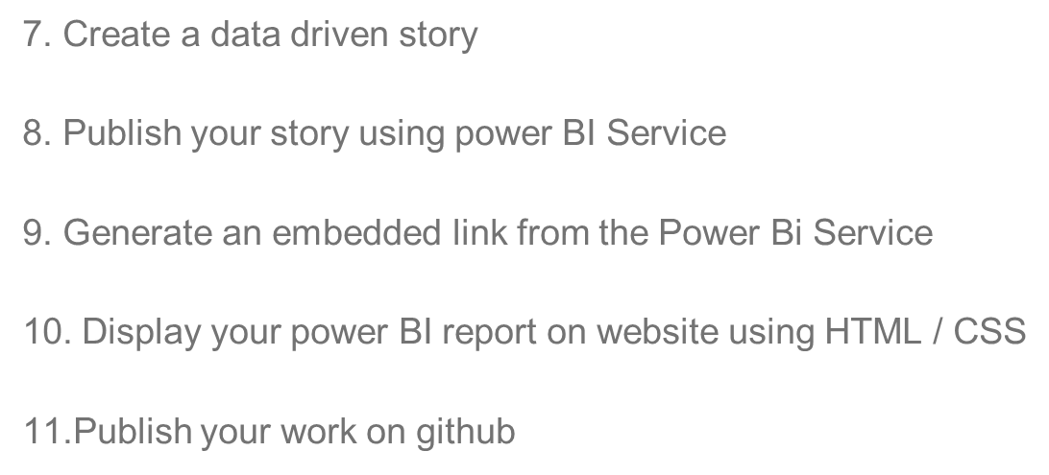
STEPS continues
STEPS

Slide 9
Q & A
Any Questions ?

